Slide 1
Presentation for Adult Protection Committee
Emma Guthrie

Slide 2
An analysis of initial case review and significant case review activity within East Ayrshire
April 2019 – March 2022

Slide 3
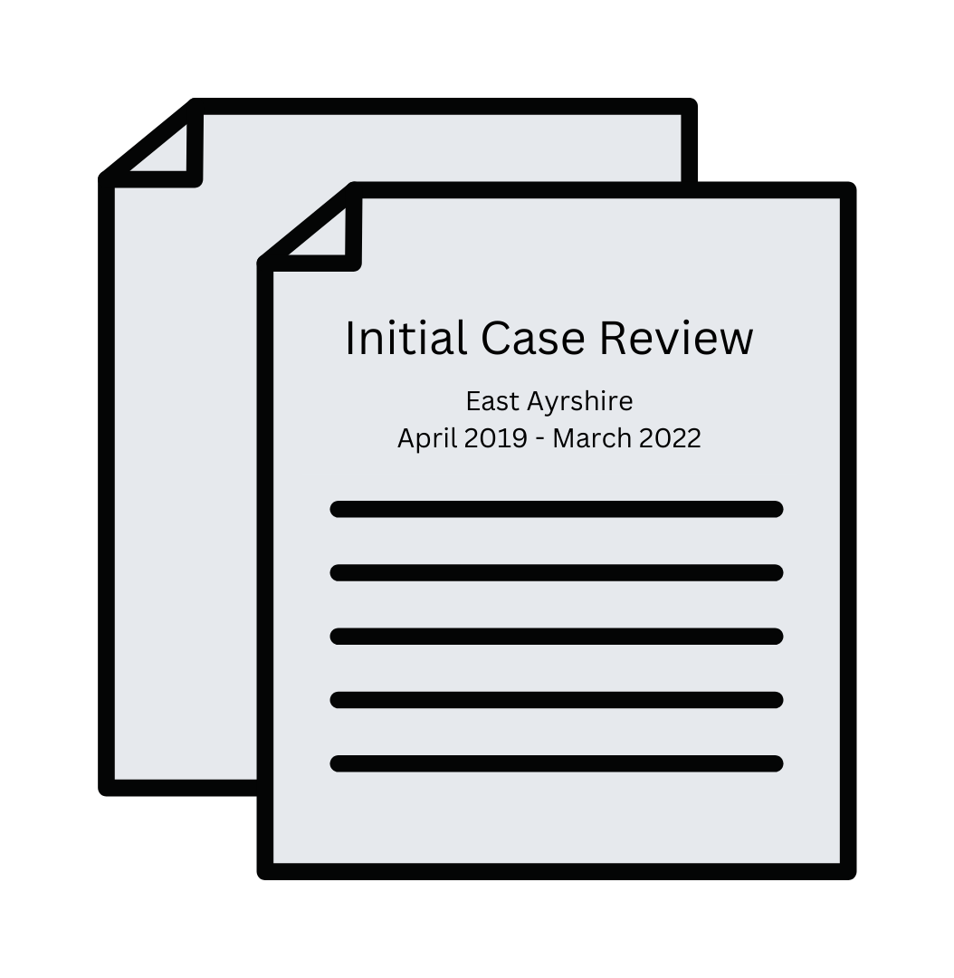
LEARNING FROM REVIEWS
Care inspectorate’s national Triennial review of Initial Case Reviews and significant case reviews for adults (2019 – 2022)

Slide 4
A clear tone and shift in language

Slide 5
Purpose

Slide 7
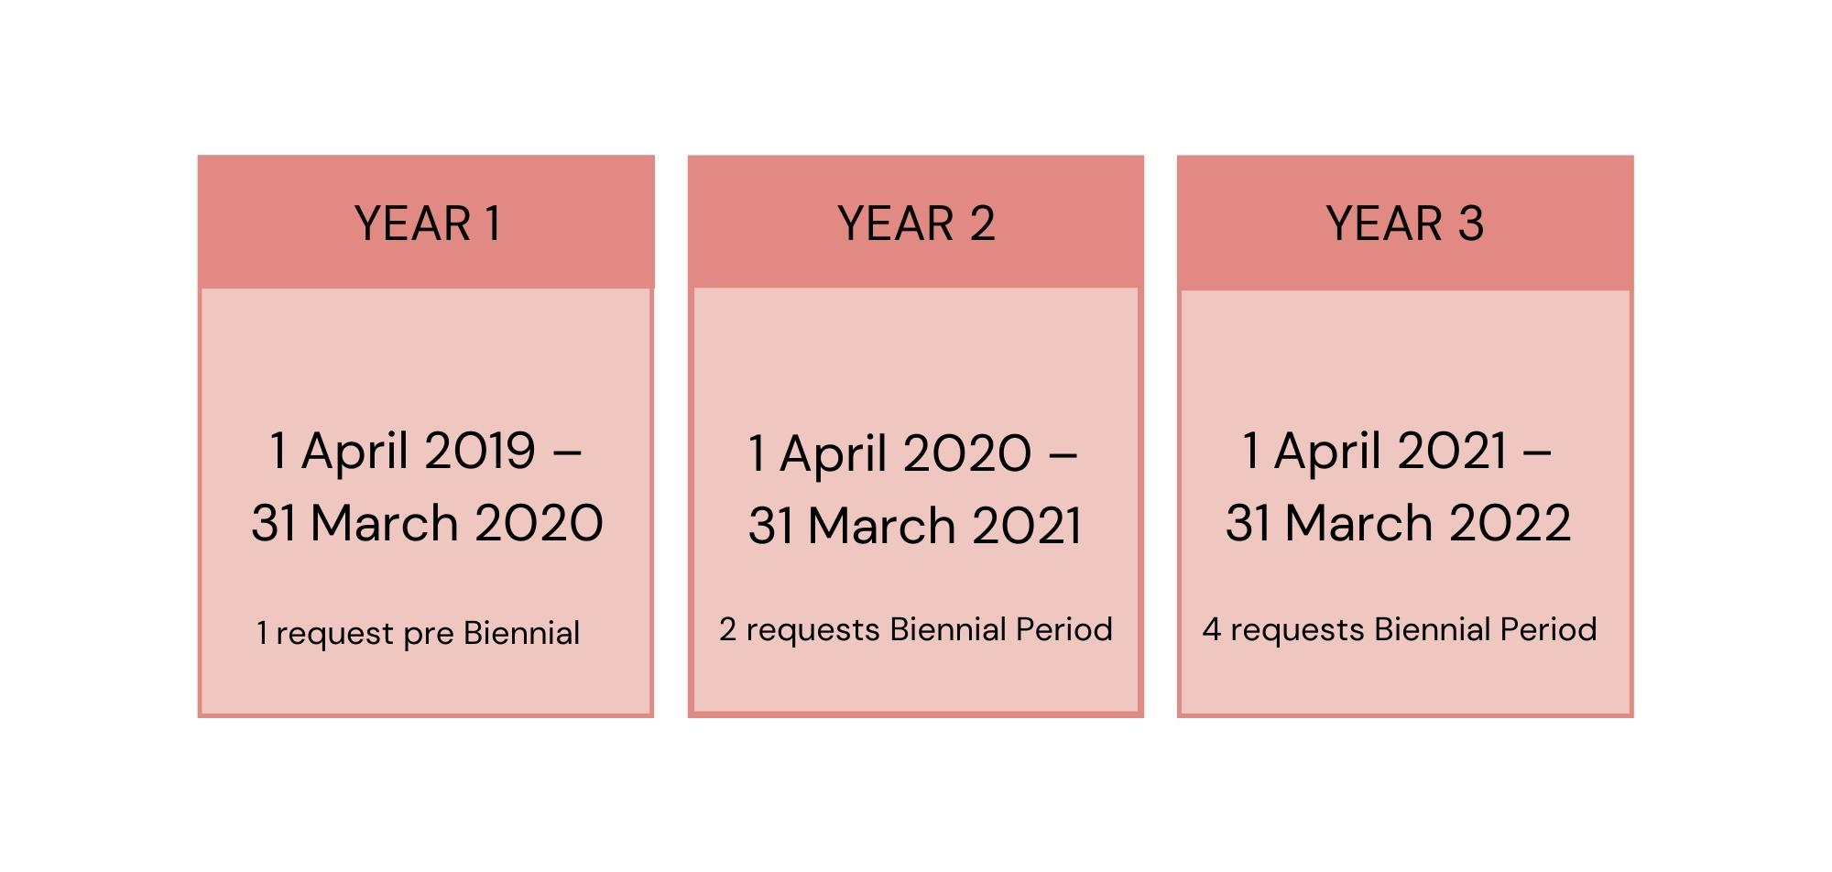
YEAR 1
YEAR 2
YEAR 3
1 April 2019 –
31 March 2020
1 request
1 April 2020 –
31 March 2021
2 requests
1 April 2021 –
31 March 2022
4 requests

Slide 8
57%
43%
Self Neglect
Neglect

Slide 9
86%
100%

Slide 10
57%
43%
57%

Slide 11
19 – 24 Years - 14%
40 – 64 Years - 43%
65 – 79 Years - 14%
80 – 84 Years - 29%

Slide 12
NEGLECT AND
SELF NEGLECT

Slide 14
Dealing with Self-Neglect for Practitioners
Trauma Informed;
Professional Curiosity;
Rights versus Risk;
Professional accountability;
How we can influence positive outcomes for individuals.

Slide 15
TRAUMA

Slide 16
Ayrshire Annual Adult Support and Protection Seminar
Grace Gilling
Ayrshire Annual Adult Support and Protection Seminar
Michael Preston Shoot
Trauma Lead Officer
Donna Walker

Slide 17
SELF NEGLECT

Slide 18
INFORMATION SHARING; RECORD KEEPING; COMMUNICATION.

Slide 19
71%

Slide 25
“IT’S EVERYONE’S BUSINESS”

Slide 27
Locally 86%
Nationally <50%

Slide 28
Self Neglect for Practitioners

Slide 32
Crossing The Acts

Slide 33
MINIMAL FORWARD
PLANNING

Slide 34
Legislative Pathways
ASP and Mental Health Coordinator

